Slide 1

CISCO Switch MAC Table
Prepared by: Mehboob nawaz

Slide 2
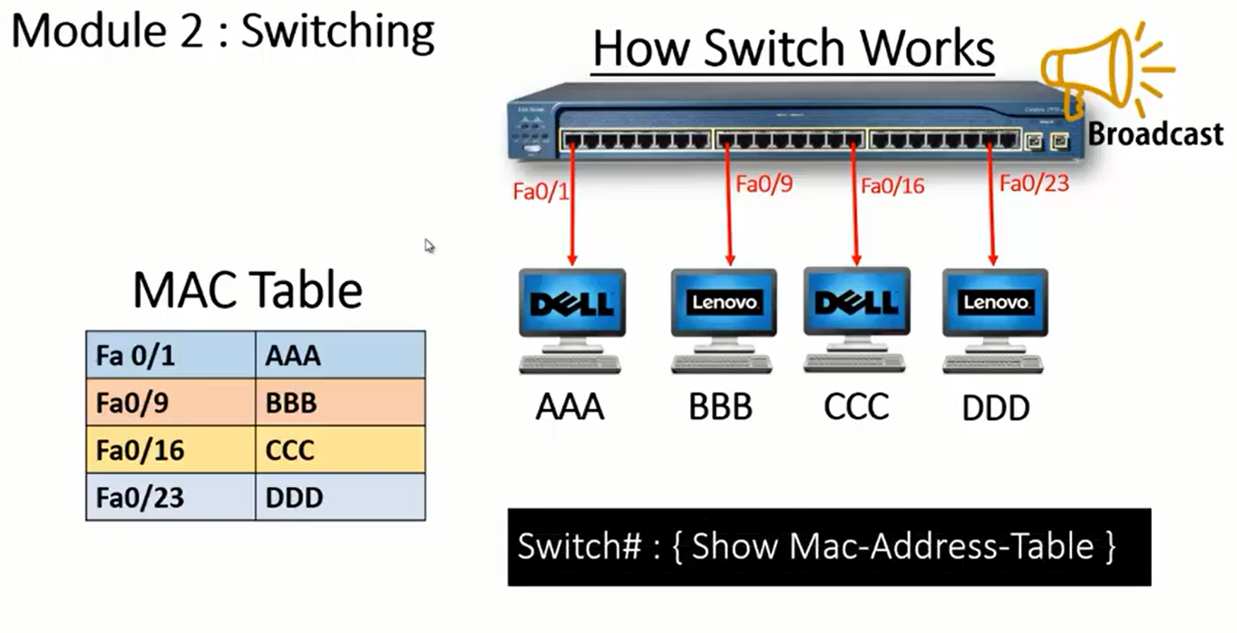
How switch maintain mac table (Mac table)

Slide 3
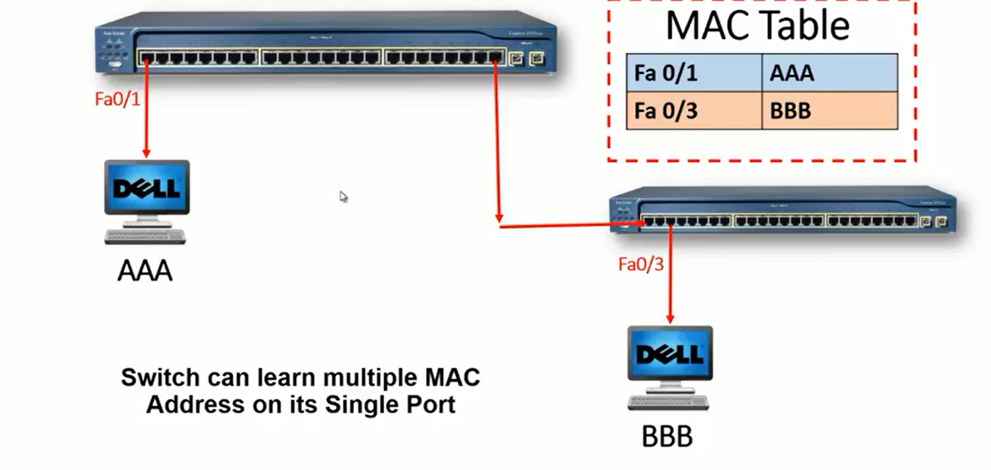
How mac table is maintained for multiple switches (two or More than two switches)

Slide 4


Thanks for Watching
Repeat the steps until you learn

